Slide 1

Classification
Logistic
Regression
Machine Learning

Slide 2
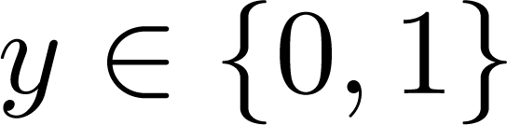
Classification
Email: Spam / Not Spam?
Online Transactions: Fraudulent (Yes / No)?
Tumor: Malignant / Benign ?
0: “Negative Class” (e.g., benign tumor)
1: “Positive Class” (e.g., malignant tumor)

Slide 3

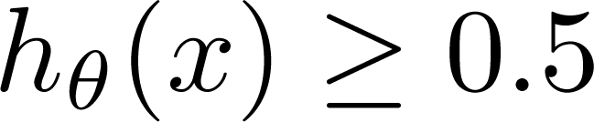
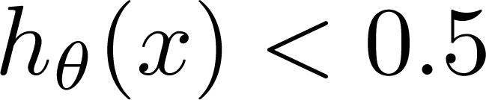
①
②
(Yes) 1
Malignant ?
(No) 0
Tumor Size
Tumor Size
Threshold classifier output at 0.5:
If , predict “y = 1”
If , predict “y = 0”

Slide 4
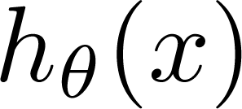
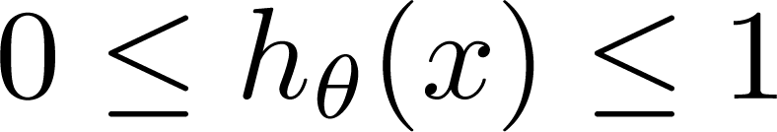
Classification: y = 0 or 1
can be > 1 or < 0
Logistic Regression:

Slide 5
Hypothesis Representation
Logistic
Regression
Machine Learning

Slide 6
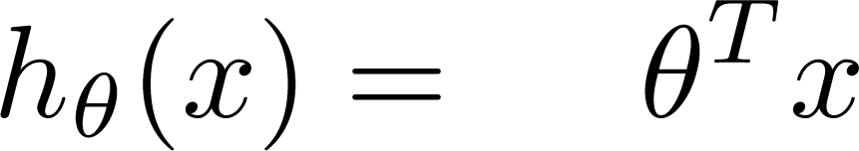
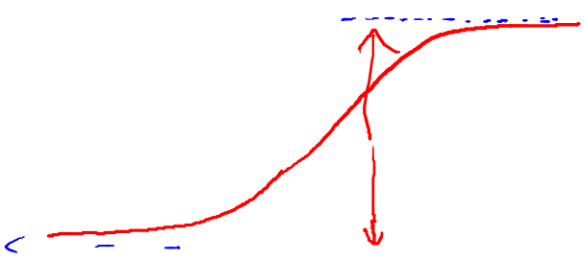
Logistic Regression Model
Want
g( )
1
Sigmoid function:
0.5
Hypothesis function:
0

Slide 7
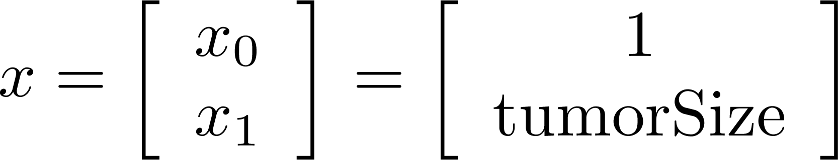
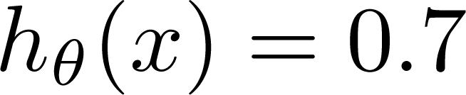
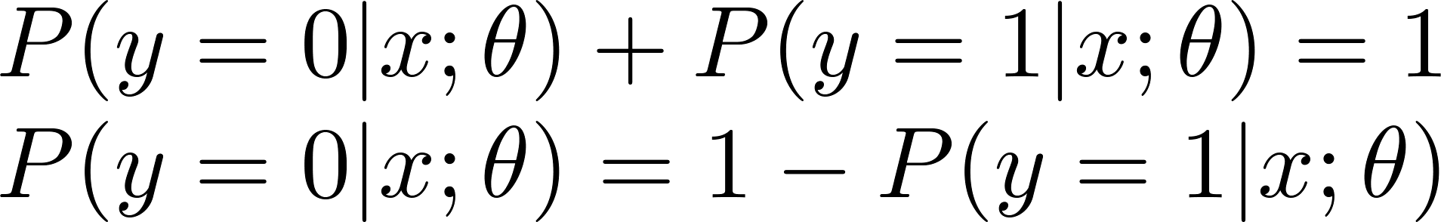
Interpretation of Hypothesis Output
= estimated probability that y = 1 on input x
Example: If
Tell patient that 70% chance of tumor being malignant
“probability that y = 1, given x,
parameterized by ”

Slide 8
Decision boundary
Logistic
Regression
Machine Learning

Slide 9
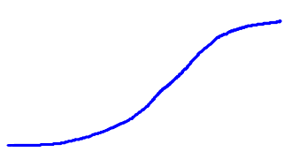

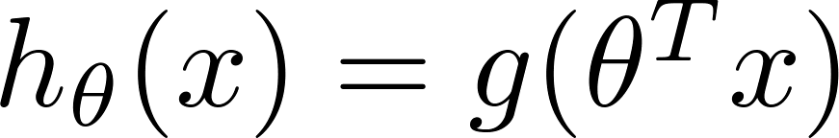
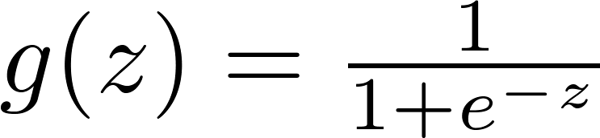

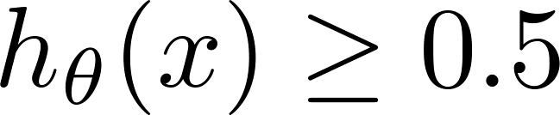

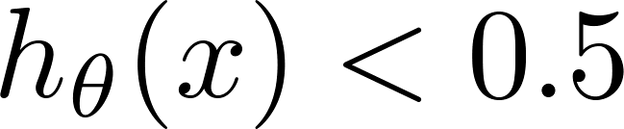
Logistic regression
1
z
Suppose predict “ “ if
predict “ “ if

Slide 10
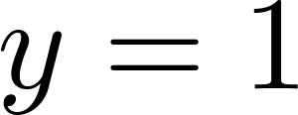

Decision Boundary
x₂
y=1
3
2
1
y=0
1
2
3
x₁
Predict “ “ if
Decision Boundary

Slide 11
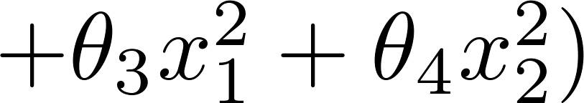
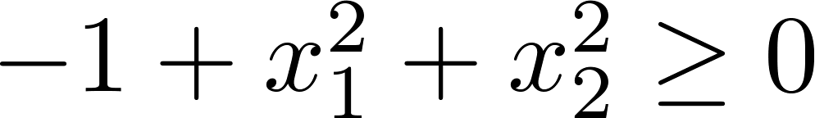
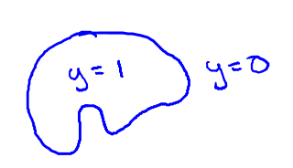
Non-linear decision boundaries
x₂
y=1
y=1
1
y=0
x₁
-1
1
-1
Predict “ “ if
y=1
y=1
x₂
Decision Boundary:
x₁

Slide 12
Cost function
Logistic
Regression
Machine Learning

Slide 13
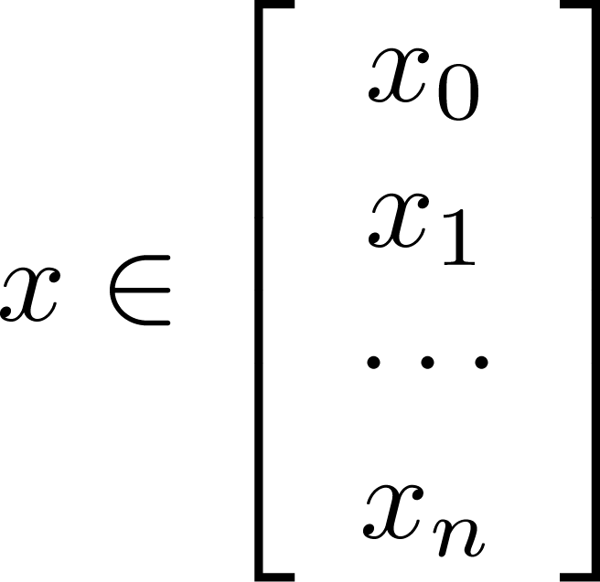
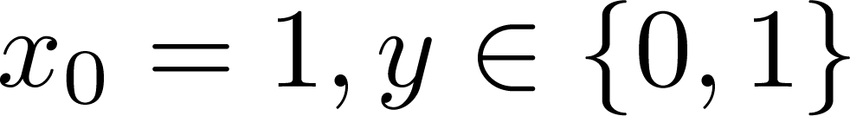
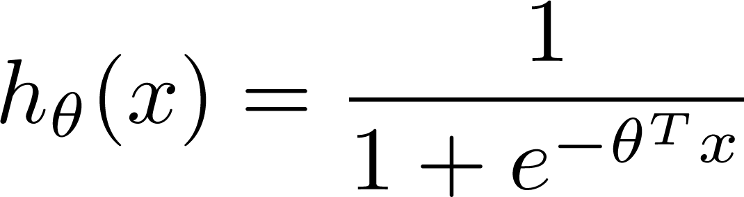

Training set:
m examples
How to choose parameters ?

Slide 14
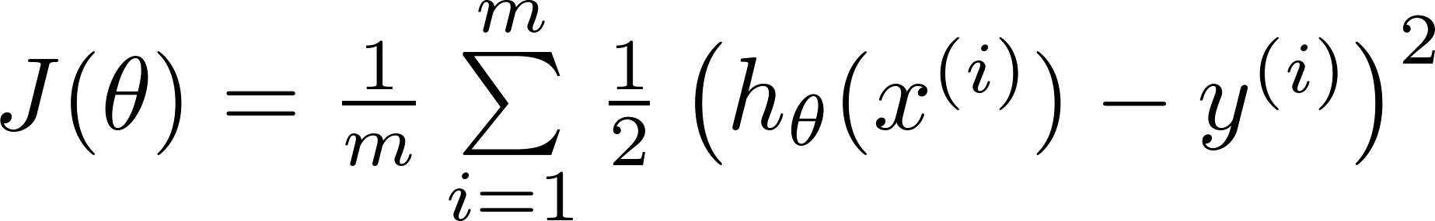
Cost function
Linear regression:
Logistic regression:
Let
is a non-convex function

Slide 15
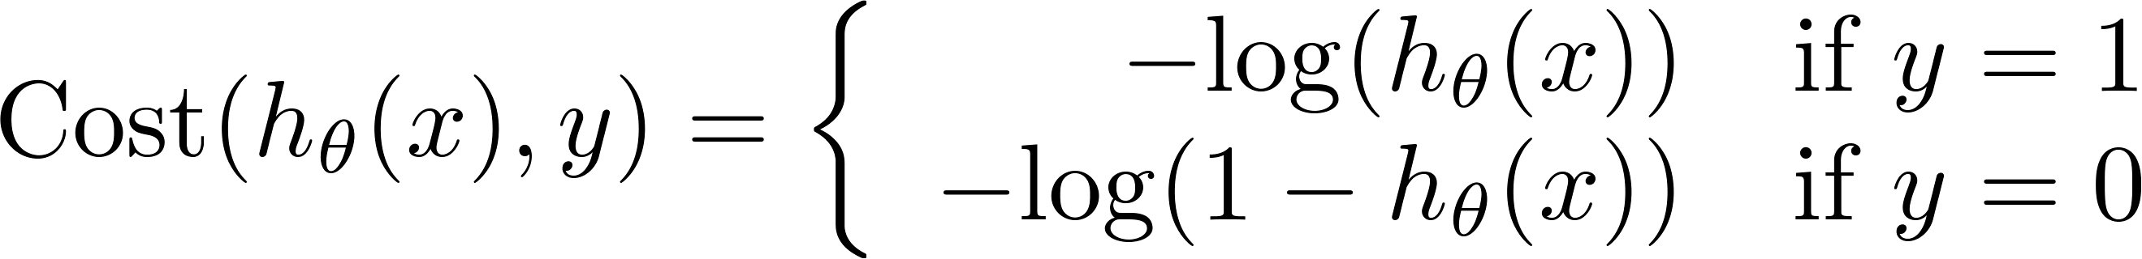
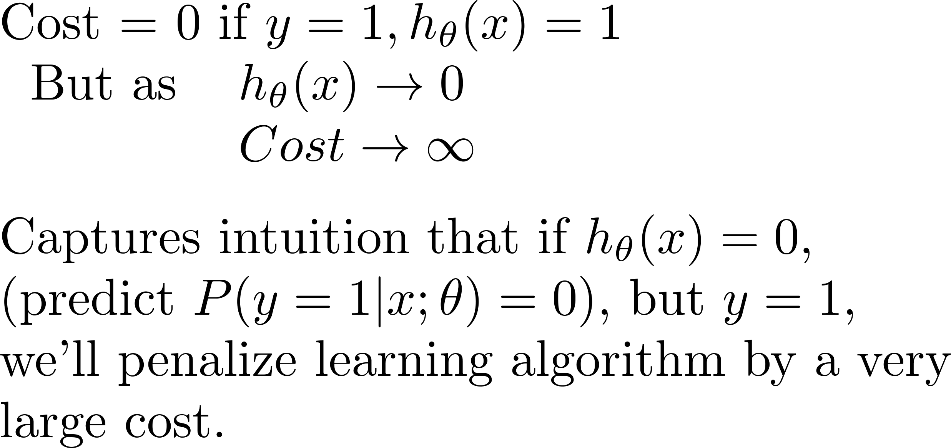
Logistic regression cost function
If y = 1
0
1

Slide 16
Logistic regression cost function
If y = 0
0
1

Slide 17
Simplified cost function and gradient descent
Logistic
Regression
Machine Learning

Slide 18
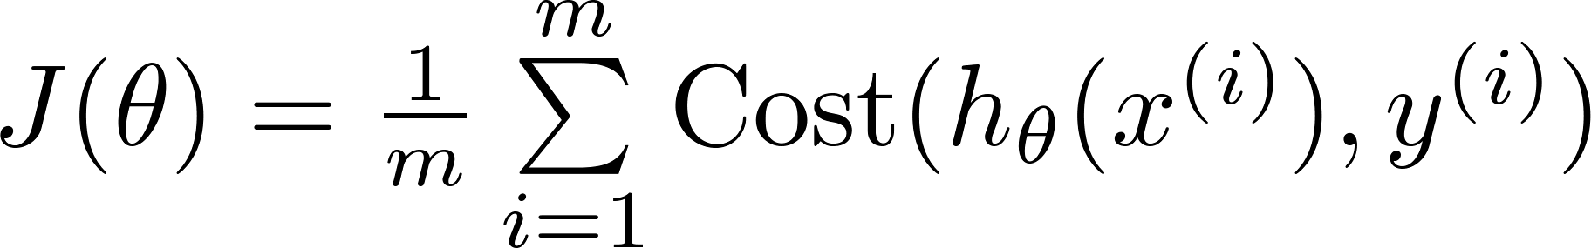
Logistic regression cost function
Simplified:

Slide 19

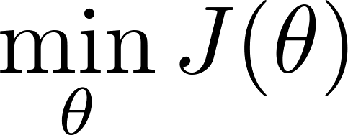

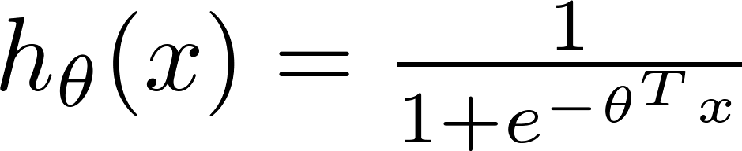
Logistic regression cost function
To fit parameters :
To make a prediction given new :
Output

Slide 20


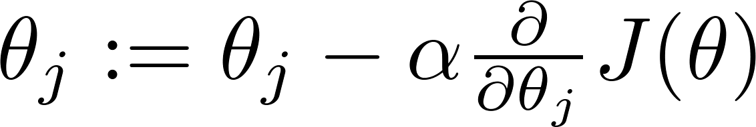


Gradient Descent
Want :
Repeat
(simultaneously update all )

Slide 21
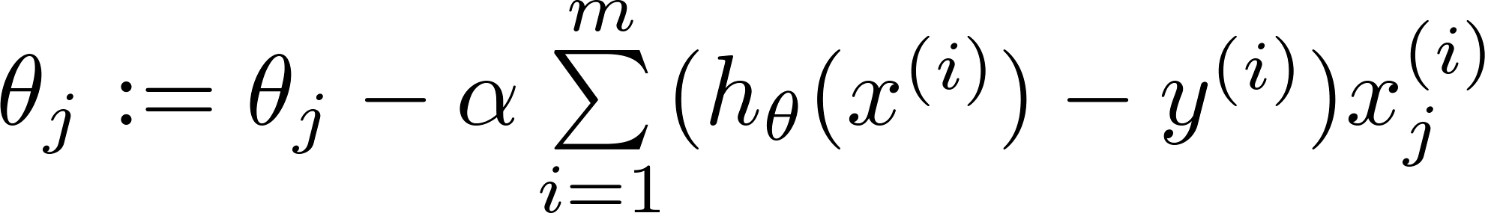
Gradient Descent
Want :
Repeat
(simultaneously update all )
Algorithm looks identical to linear regression!

Slide 22
Advanced optimization
Logistic
Regression
Machine Learning

Slide 23

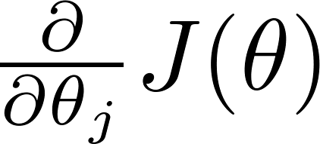
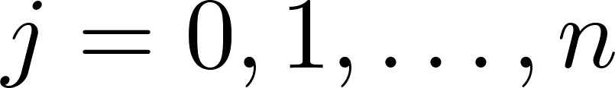
Optimization algorithm
Cost function . Want .
Given , we have code that can compute
(for )
Gradient descent:
Repeat

Slide 24

Optimization algorithm
Given , we have code that can compute
(for )
Optimization algorithms:
Gradient descent
Advantages:
No need to manually pick
Often faster than gradient descent.
Disadvantages:
More complex
Conjugate gradient
BFGS
L-BFGS

Slide 25
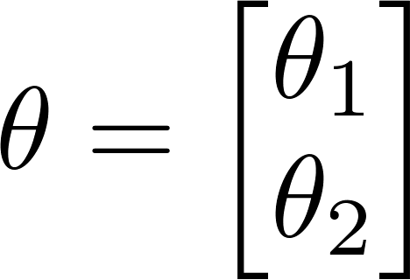
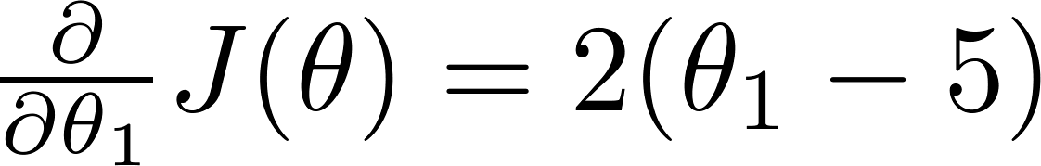

Example:
function [jVal, gradient] = costFunction(theta)
jVal = (theta(1)-5)^2 + ... (theta(2)-5)^2;
gradient = zeros(2,1);
gradient(1) = 2*(theta(1)-5); gradient(2) = 2*(theta(2)-5);
options = optimset(‘GradObj’, ‘on’, ‘MaxIter’, ‘100’);
initialTheta = zeros(2,1); [optTheta, functionVal, exitFlag] ...
= fminunc(@costFunction, initialTheta, options);

Slide 26

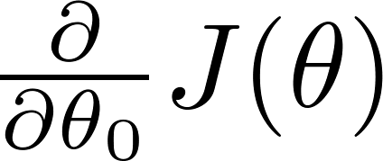
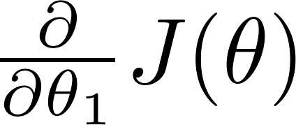
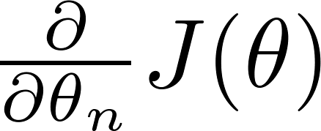
theta =
Caution the subscript!
function [jVal, gradient] = costFunction(theta)
code to compute
jVal = [ ];
code to compute
gradient(1) = [ ];
code to compute
gradient(2) = [ ];
code to compute
gradient(n+1) = [ ];

Slide 27
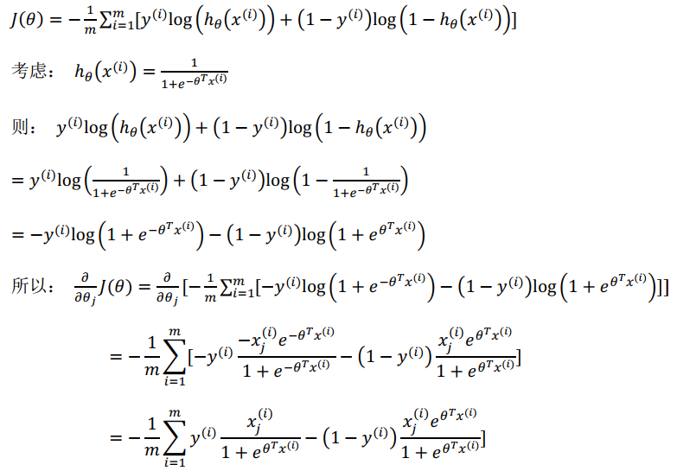
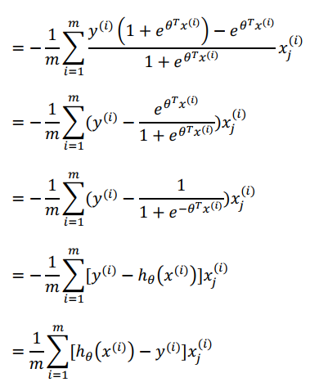
的推导过程（选修）

Slide 28
Multi-class classification: One-vs-all
Logistic
Regression
Machine Learning

Slide 29
Multiclass classification
Email foldering/tagging: Work, Friends, Family, Hobby
y= 1 2 3 4
Medical diagrams: Not ill, Cold, Flu
y= 1 2 3
Weather: Sunny, Cloudy, Rain, Snow
y= 1 2 3 4

Slide 30
Binary classification:
Multi-class classification:
x₂
x₂
x₁
x₁

Slide 31
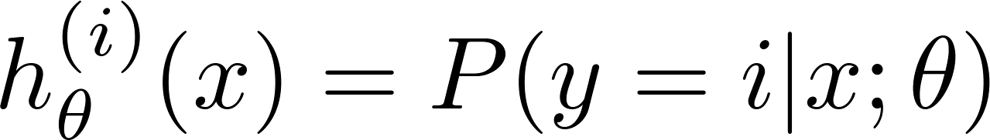

x₂
One-vs-all (one-vs-rest):
x₁
x₂
x₂
x₁
x₁
Class 1:
Class 2:
Class 3:
x₂
x₁

Slide 32
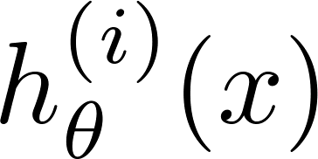

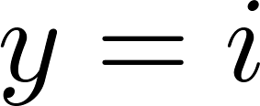
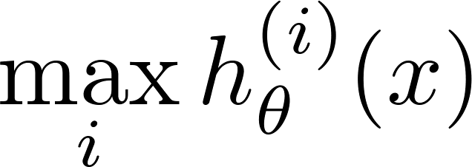
One-vs-all
Train a logistic regression classifier for each class to predict the probability that .
On a new input , to make a prediction, pick the class that maximizes

Slide 33

第4章 逻辑回归重点
逻辑回归的假设函数、代价函数、优化目标、梯度下降对参数theta的更新
逻辑回归的预测输出的取值范围及其意义：
Sigmoid 函数公式及图形
在什么情况下预测y=1?什么情况下预测y=0? 决策边界是什么？
对于K（K>2）分类问题，需要设计（ K ）个二元分类器，给定一个新的样本x，它属于第i类的判断依据：
= estimated probability that y = 1 on input x

